Slide 1
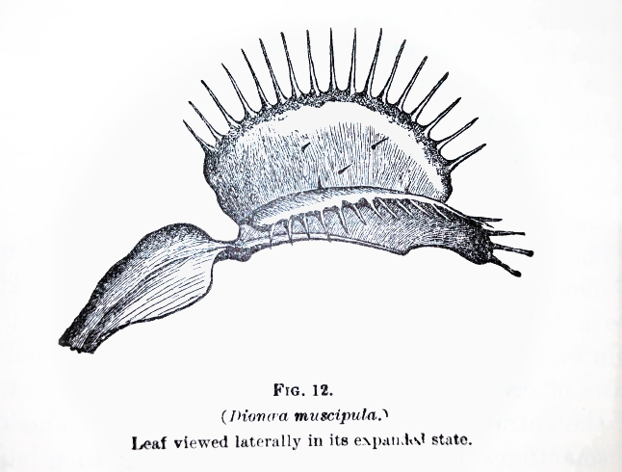
Venus Flytraps:
A Case Study for Stronger Plant Poaching Enforcement
Presenter: Katrina Outland
katrinaoutland@hotmail.com

Slide 2
Overview
Poaching basics
Plant protection laws & Lacey Act basics
Example of Lacey Act in action– United States v. J & L Tonewoods
Venus flytraps & proposed way to use Lacey Act
Practical issues & hurdles to overcome

Slide 3
Poaching is…?
Black’s Law: “Illegal taking or killing of fish & game on another’s land” (not plants)
“Taking”= very broad, i.e., could include unintentional harm (trampling, development)
Working definition:
The intentional
collecting or killing
of plant or animal
without lawful permission

Slide 4
Why
Poach?
poverty
organized crime
culture
rebellion
thrill
trophy
global illegal wildlife/plant trade estimated $200 billion/year, only outranked by international drug trade

Slide 5
Why Prosecute Plant Poaching?
deterrence– send strong message
ties with other crimes
allow opportunities for diversion, connect to support services
protect businesses that deal fairly
prevent spread of invasive species or disease
protect plants themselves & ecosystem– biodiversity, local culture, interlinked species
carnivorous plants– prevent spread of insect-vector diseases

Slide 6
Brief Overview of Plant Laws
CITES (Convention on Int’l Trade in Endangered Species of Wild Fauna and Flora)
Endangered Species Act; Lacey Act
State
Laws

Slide 7
Endangered Species Act
Only protects plants on federal land
Only protects from actual possession or intentional violations of state laws
Difficult to enforce
Publishing Critical Areas can cause more harm
Slow and difficult to get listed
Rock Gnome Lichen. Photo: Hugh & Carol Nourse

Slide 8
State Laws
Washington’s Specialized Forest Products Act: state permit for harvesting; buyers must check & record permits from sellers.
Arizona Native Plants Act: Permits for taking, transporting, or possessing native plants only issued for scientific or noncommercial salvage; wild saguaro cacti given additional protections. A.R.S. §3-906.
Texas’ Endangered Plants: Permit needed by each person for commercial taking, possessing, transporting, or selling any part of listed plant on private land, AND each plant has to be tagged. These activities prohibited if the plant is from public land. Vernon’s Tex. Stat. C. §88.008

Slide 9
Lacey Act
Plant provisions greatly strengthened in 2008 amendments
Prohibits 3 types of acts:
import foreign plants improperly. 16 USC 3372(f)
falsely labeling plants for foreign or interstate commerce. 16 USC 3372(d)
“other”: selling, receiving, acquiring, or purchasing of any plant taken or possessed in violation of federal, tribal, state, or foreign law;
legal harvest but transported without paying required fee/tax. 16 USC 3372(a)

Slide 10
Example case of Lacey Act in action

Slide 11
United States v. J & L Tonewoods
Lumber mill J & L Tonewoods bought big leaf maple taken from Gifford Pinchot National Forest
Charged 3 “maple cutters” for theft & damage to government property
Charged the company & sole owner for knowingly buying stolen maple→ Lacey Act violation! § 3372(a)(2)(B) & 3373(d).
Profited >$800,000 from stolen maple in 2 years.
Indicted then settled
Screenshot of Google image search: “figured maple”

Slide 12
State Law
WA Specialized Forest Products Act, RCW 76.48.031– need state permit for harvesting listed plants
Target Dealer
Purchaser must record the seller’s permit!
RCW 76.48.111
16 USC § 3372(a)(2)(B):
“knowingly engage in conduct that involved the sale & purchase of plants…knowingly sell & transport said plants in interstate commerce, knowing that [they had been taken] in violation of state law.”
16 USC § 3373(d):
sold & transported maple knowing it had been taken in violation of state law
Lacey Act
(also) 18 USC § 641, § 2: receipt of stolen federal property

Slide 13
Venus Flytrap (Dionae muscipula)
Unique species
Native only to one region of North & South Carolina
Currently pending listing as endangered species
High demand by collectors & for use in pseudo-science tonics
Photo by Noah Elhardt

Slide 14
North Carolina’s Venus flytrap laws
Felony taking: “[a]ny person, firm, or corporation who digs up, pulls up, takes, or carries away. . . any Venus flytrap [plant or seed]. . . growing upon the lands of another person, or from the public domain, with the intent to steal.” N.C. Gen. Stat § 145-22.
Penalty increased: old max. misdemeanor $50 → 4 to 30 months prison
Plant Conservation Laws: Collector’s permit must be in person’s possession at the time they dig, pull, take, or carry away the flytrap. N.C. Gen. State § 14-129.3(b).

Slide 15
Case Updates
Few prosecutions under felony law
Enforcement still has to catch poachers in the act
Some deterrence?
Plant surveys 2013-2017 in Green Swamp Preserve
year that felony law was passed
Surveys conducted by Roger Shew of University of North Carolina Wilmington

Slide 16
216 counts
https://portcitydaily.com/local-news/2019/03/18/man-charged-with-73-counts-of-poaching-venus-flytrap-bond-at-750000/

Slide 17
How to Equitably Curb Poaching?
Layer 1:
Tougher penalties
Layer 2:
Prove buyer’s criminal intent
Layer 3:
Aim Lacey Act at buyers
Stronger deterrence, but reinforces cycle of poverty
Track plants, greater protection for wild populations
Shift burden of crime to those making more profits & driving the market

Slide 18
State Law
NC § 145-22:
Poacher digs up & carries away Venus flytraps from state park with intent to steal
Target Dealer
NC § 106-202.19(a)(6a):
poacher doesn’t have required permit
NC § 106- 202.19(a)(6c):
Dealer buys flytraps outside of buying season without getting the poacher’s permit
16 USC § 3373(d):
Civil: buyer didn’t use due care to make sure flytraps weren’t illegally taken/possessed.
Misdemeanor: buyer sells/buys flytraps (or intends to) and using due care should know plants were taken illegally.
Felony: Buyer knew the plants were taken illegally
Lacey Act

Slide 19
How to Track Where Plants Came From?
Require buyers to maintain records of their sources’ permits
(like WA’s Specialized Forest Products Act)
Require buyers to get & maintain their own permits (like ginseng)
Biological marking system?
fluorescent dye in ginseng roots
DNA matching stolen lumber to stumps
orange dye on Green Swamp Preserve flytraps

Slide 20
Sources & Extra Materials
Arizona Native Plants Act: A.R.S. § 3-901 et seq.
Wallace v. Shields, 854 P.2d 1152 (Ct. App. Ari., 1992): Wallaces owned crested saguaro cacti that had allegedly been stolen from public and private land. Upheld state agency’s authority for seizing the plants, but lack of post-seizure hearing on whether cacti were likely stolen unconstitutionally denied the Wallaces’ due process.
Vanessa Dick, Dirty Money and Wildlife Trafficking Using the Money Laundering Control Act, 49 Envtl. L. Rep. News & Analysis 20334 (2019). (proposes a way to link wildlife trafficking and financial crimes through the Lacey Act and the Money Laundering Control Act to target harsher penalties at organized crime “kingpins.” Unfortunately, the law doesn’t currently include plant trafficking).
Makenzie Holland & Tim Buckland, Trying to Keep Venus’ Flytrap Poachers at Bay, JD News (Mar. 27, 2018).
Christina M. Russo, Criminal Prosecution for Environmental Lawbreakers: A Statute with No Bite, 28 Vill. Envtl. L.J. 97 (2017). (largely criticizes federal environmental crime prosecution but argues that more consistent sentencing will lead to stronger deterrence).
Marcus A. Asner, To Catch a Wildlife Thief: Strategies and Suggestions for the Fight Against Illegal Wildlife Trafficking, 12 U. Penn. Asian L. Rev. 1 (2017) (practical breakdown & suggestions for gathering evidence and building a case in large-scale wildlife trafficking rings).
Ursula Ramsey, Community Orchards and Food Security in Appalachia, 120 W. Va. L. Rev. 1063 (2018). (more insight into level of poverty in Appalachia)

Slide 21
Questions & Input

